Slide 1

Decoding Feature Disambiguation In Polysemantic Neurons
Matthew Nguyen
05/10/2025

Slide 2
Motivation
Polysemantic neurons muddle multiple concepts into a single channel → opaque model reasoning
Downstream systems must “know” when to trust or cancel an ambiguous signal; understanding how is critical for reliability and editing
Decoding the disambiguation mechanism can guide new interpretability tools and more robust architectures
Notes:
The motivation of this project

Slide 3
Background
Polysemanticity: one neuron fires for several unrelated features due to superposition/compression
Residual stream = vector sum of all neurons; later layers (or neighbours) can add/cancel directions

Slide 4
Related Work
Circuits & feature “atoms” (Olah et al.; Anthropic SAEs) try to find monosemantic bases
Superposition theory (Hubinger et al.) shows sparse features overlap and need nonlinear filters
Dreyer et al., Marks et al. propose algorithmic disentanglement; this work observes native disambiguation

Slide 5
Claim / Target Task
We want to see how a model disambiguates different features
Claim: small context‑specific neuron teams cancel / reinforce a polysemantic neuron, steering logits correctly
One‑layer Transformer (GELU‑1L) offers a minimal testbed: only attention + MLP before unembedding
Notes:
Here, we make the claim of this project.

Slide 6
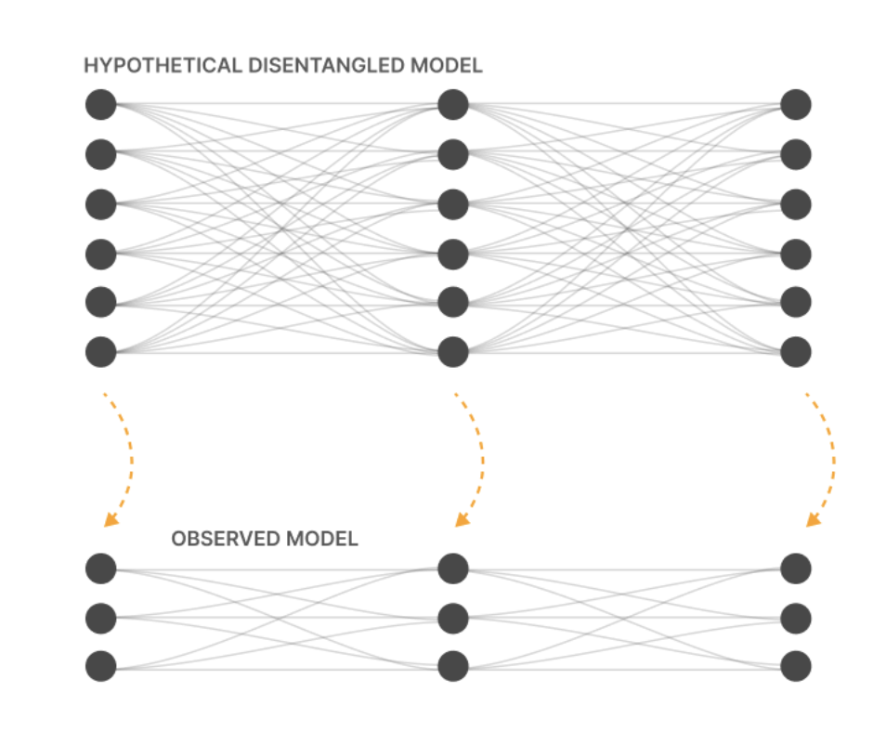
An Intuitive Figure Showing WHY Claim
Notes:
Here, we make the claim of this project.

Slide 7
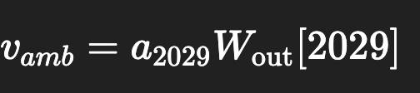
Proposed Solution
Quantify contribution vector for a polysemantic neuron:
Measure cosine between v_amb and rest‑of‑layer to detect cancellation vs reinforcement
Identify & ablate top k neurons with strongest negative (or positive) alignment per context
Notes:
Here is our proposed solution.

Slide 8
Implementation
Framework: Transformer‑Lens hooks; one forward pass captures activations and residuals
Vector arithmetic & dot‑products in PyTorch; no retraining required
Ablation via hook that zeros selected neuron activations during inference
Notes:
In the rest of this presentation, I’m going to talk about following contents:

Slide 9
Data Summary
Two evaluation prompts representative of each feature + 100 random validation prompts
Notes:
In the rest of this presentation, I’m going to talk about following contents:

Slide 10
Experimental Results
Cosine(v amb, rest) = +0.22 in English (reinforce), –0.30 in code (cancel)
Context‑A canceler set (5 neurons) ↑ “and” logit margin +0.49 logits when ablated
Context‑B canceler set ↓ “range” logit margin –0.94 logits when ablated; cross‑context ablations ≈ 0 effect
Notes:
In the rest of this presentation, I’m going to talk about following contents:

Slide 11
Experimental Analysis
Disambiguator sets are disjoint→ highly targeted control
Removing both canceler sets lets punctuation tokens dominate, confirming 2029’s raw direction
Similar patterns found for 3 other polysemantic neurons, suggesting general phenomenon
Notes:
In the rest of this presentation, I’m going to talk about following contents:

Slide 12
Conclusion and Future Work
Pre-activation attention analysis
Scale insight to deeper models
Explore disambiguator circuits

Slide 13
References
Olah et al., “Zoom In” (2020) – polysemantic neurons & circuits
Hubinger et al., “Superposition, a Survey” (2022)
Dreyer et al., “PURE: Disentangling Polysemantic Neurons” (2024)
Marks et al., “Sparse Feature Circuits” (ICLR 2025)
Dunefsky et al., “MLP Transcoders for Mechanistic Interpretability” (2024)

